Slide 1
Part 46/48 Training Plan Approval
Notes:
This template can be used as a starter file for presenting training materials in a group setting.
Sections
Right-click on a slide to add sections. Sections can help to organize your slides or facilitate collaboration between multiple authors.
Notes
Use the Notes section for delivery notes or to provide additional details for the audience. View these notes in Presentation View during your presentation.
Keep in mind the font size (important for accessibility, visibility, videotaping, and online production)
Coordinated colors
Pay particular attention to the graphs, charts, and text boxes.
Consider that attendees will print in black and white or grayscale. Run a test print to make sure your colors work when printed in pure black and white and grayscale.
Graphics, tables, and graphs
Keep it simple: If possible, use consistent, non-distracting styles and colors.
Label all graphs and tables.

Slide 2
Federal Mine Safety & Health Act of 1977
SEC. 115. (a) Each operator of a coal or other mine shall have a health and safety training program which shall be approved by the Secretary.

Slide 3
Part 46
Section 46.3 requires you to develop and implement a written training plan that in­cludes programs for:
• new miners (§46.5),
• newly hired experienced miners (§46.6),
• new tasks (§46.7),
• annual refresher (§46.8), and
• site-specific hazard awareness training (§46.11) - - (Independent contractors do not need to include (§46.11) in their training plan).
Notes:
Give a brief overview of the presentation. Describe the major focus of the presentation and why it is important.
Introduce each of the major topics.
To provide a road map for the audience, you can repeat this Overview slide throughout the presentation, highlighting the particular topic you will discuss next.

Slide 4
Site-specific hazard awareness training
Production-operators may arrange for the independent contractors to provide the training to the contractors’ employees. Where this arrangement is made, the production-operator must list the independent contractor by name and document in their training plan that the independent contractor identified will be providing Site-specific Hazard Awareness.
Notes:
This is another option for an Overview slides using transitions.

Slide 5
Part 46.3(b) provides that a training plan is considered approved by MSHA if it contains—
The name of the production-operator or independent contractor, mine name(s), and MSHA mine identification number(s) or independent contractor identification num­ber(s);
A production-operator can list more than one Mine ID number on a training plan. For each mine identification number listed on a training plan, there needs to be a corresponding mine name.
(2) The name and position of the person designated by the production-operator or in-dependent contractor who is responsible for the health and safety training at the mine. This person may be the production-operator or independent contractor;

Slide 6
(3) A general description of the teaching methods and the course materials that are to be used in each training program, including the subject areas to be covered and the approximate time to be spent on each subject area;
(4) A list of the persons and/or organizations who will provide the training, and the subject areas in which each person and/or organization is competent to instruct; and
(5) The evaluation procedures used to determine the effectiveness of training.

Slide 7
Plans that do not contain the minimum information required by the rule must be submit­ted to one of the Regional Managers for Educational Field Services for approval.

Slide 8
Annual Refresher
In the regulation, the section on annual refresher training lists recommended subjects that could be included in the training. It is not acceptable to list all these subjects on the training plan and choose different subjects from year-to-year. The training plan needs to accurately represent each subject which you plan to cover during annual refresher training.
Notes:
This is another option for an Overview slide.

Slide 9
Class size
There are no regulatory requirements for class size however; we have identified some factors that we take into consideration when we set maximum class sizes for our programs.
Students who interact in class with the instructor, and with other students, have significantly higher levels of satisfaction with their learning experience than students in classes that were taught exclusively by the lecture method. In large-class settings, a “compact of disengagement” exists between instructors and students, which seem to convey the mutual message: “You leave me alone and I will leave you alone”.
Notes:
What will the audience be able to do after this training is complete? Briefly describe each objective how the audience will benefit from this presentation.

Slide 10
Computer Based Training
MSHA considers computer based or other interactive training technologies to be training "methods," to be used by an instructor effectively and appropriately. This would not necessarily require that the instructor be in the room at all times; however, the instructor must be available to evaluate the trainee’s progress, and answer questions as they arise.
MSHA encourages the use of computer-based and other innovative training methods, where an instructor would facilitate the delivery of training rather than provide it directly.
Notes:
Use a section header for each of the topics, so there is a clear transition to the audience.

Slide 11
Training may be provided ‘‘under the direction of an instructor, this should not be wrongly interpret it to mean that computer-based or any other type of electronic or interactive training method could serve as a total substitute for a human instructor and human interaction. We consider computer-based or other interactive training technologies to be training ‘‘methods,’’ to be employed by an instructor effectively and appropriately. To make clear it that we encourage the use of computer technology in satisfying training requirements.
Notes:
Add slides to each topic section as necessary, including slides with tables, graphs, and images.
See next section for sample table, graph, image, and video layouts.

Slide 12
Part 48
Section 115 of the Federal Mine Safety and Health Act of 1977 (Mine Act) and 30 CFR Part 48 require operators to submit and obtain approval of training plans under which miners are provided training. The training required by these plans must be provided to miners
Notes:
Keep it brief. Make your text as brief as possible to maintain a larger font size.

Slide 13
Part 48 applies to coal mines, underground metal and nonmetal mines, surface metal mines, and certain surface nonmetal mines that are not in the following industries: surface stone, surface clay, sand and gravel, surface limestone, colloidal phosphate, and shell dredging mines and other surface operations that produce marble, granite, sandstone, slate, shale, traprock, kaolin, cement, feldspar, and lime. These mining industries

Slide 14
Each operator must submit the information required by Section 48.3(c)/48.23(c), and may use a format that is logical and reasonable. There is an optional electronic version available on the MSHA

Slide 15
mine shall have an MSHA-approved plan containing programs for training
new miners,
training experienced miners,
training miners for new tasks,
annual refresher training, and
hazard training for miners

Slide 16
The training plan shall be filed with the District Manager for the area in which the mine is located.

Slide 17
Each operator shall submit
The company name, mine name, and MSHA identification number of the mine
Person designated by the operator who is responsible for health and safety training
A list of MSHA approved instructors
The location where training will be given for each course
A description of the teaching methods and the course materials which are to be used in training
The approximate number of miners employed at the mine and the maximum number who will attend each session of training.

Slide 18
Operators must indicate a predicted time that training will occur, such as the first week of each quarter. Specific days and times of the training can be obtained by MSHA, as needed, upon request.
If changes are made to the list of MSHA approved instructors, they are not required to be submitted to MSHA for approval, provided that the list of approved instructors is maintained with the approved plan at the mine

Slide 19
The predicted time or periods of time when regularly scheduled refresher training will be given. This schedule shall include the titles of courses to be taught, the total number of instruction hours for each course, and the predicted time and length of each session of training.

Slide 20
A complete list of task assignments
The titles of personnel conducting task training
The outline of training procedures used in task training work assignments
The evaluation procedures used to determine the effectiveness of training under § 48.27

Slide 21
Within 60 days after the operator submits the plan for approval, unless extended by MSHA, the operator shall have an approved plan for the mine.

Slide 22
At the discretion of the District Manager, new miners may receive a portion of this training after assignment to work duties: Provided, That no less than 8 hours of training shall in all cases be given to new miners before they are assigned to work duties

Slide 23
PART 75.160/77.107
Every operator of a coal mine shall provide a program, approved by the Secretary, of training and retraining of both qualified and certified persons needed to carry out functions prescribed in the Act.

Slide 24
75.161/77.107–1
Each operator must submit to the district manager, of the Coal Mine Safety and Health District in which the mine is located, a program or plan setting forth what, when, how, and where the operator will train and retrain persons whose work assignments require that they be certified or qualified.
The program must provide—
(a) For certified persons, annual training courses in first aid, principles of mine rescue, and the provisions of this part 75; and
(b) For qualified persons, annual courses in performance of the task which they perform as qualified persons.

Slide 25
Notes:
Summarize presentation content by restating the important points from the lessons.
What do you want the audience to remember when they leave your presentation?
Save your presentation to a video for easy distribution (To create a video, click the File tab, and then click Share. Under File Types, click Create a Video.)

Slide 26
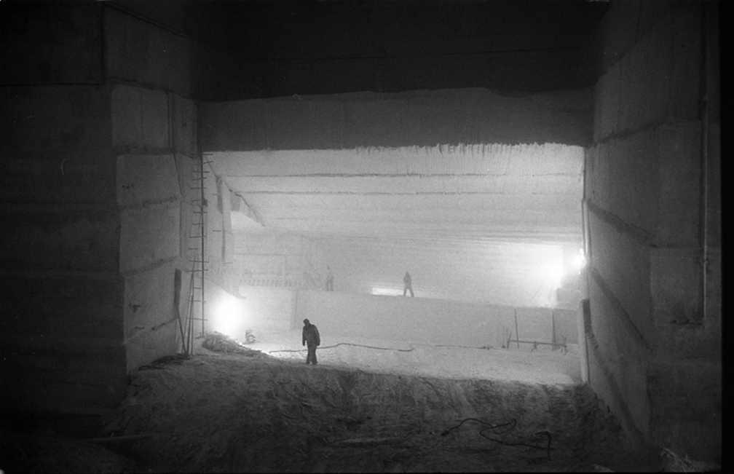
Questions?

